Slide 1
RAG Chatbots for AWS Data Lakes
How to Query Your Data Lake with Natural Language
Mamoon Chowdry
Solution Architect
Notes:
Good day everyone. Today, we're diving into a novel approach that bridges vast data lakes with everyday human conversation.
Data is invaluable, but its true potential is sometimes locked behind complex retrieval processes and technical barriers.
Traditional methods require intricate queries and a deep understanding of your data’s structure, making it challenging for many to extract meaningful insights.
Envision a world where you can effortlessly converse with your data, asking questions as naturally as you would to a colleague.
Our solution, A-RAG, modernizes this interaction, making data accessibility as simple as having a chat.
Let’s discuss how to redefine how we interact with, understand, and leverage our data assets.

Slide 2
What will we cover?
Why is it hard to have conversations with my data?
Introducing a new Retrieval Augmented Generation (RAG) chatbot
How it works
AWS Architecture

Slide 3
Why is it hard to have conversations with my data?

Slide 4
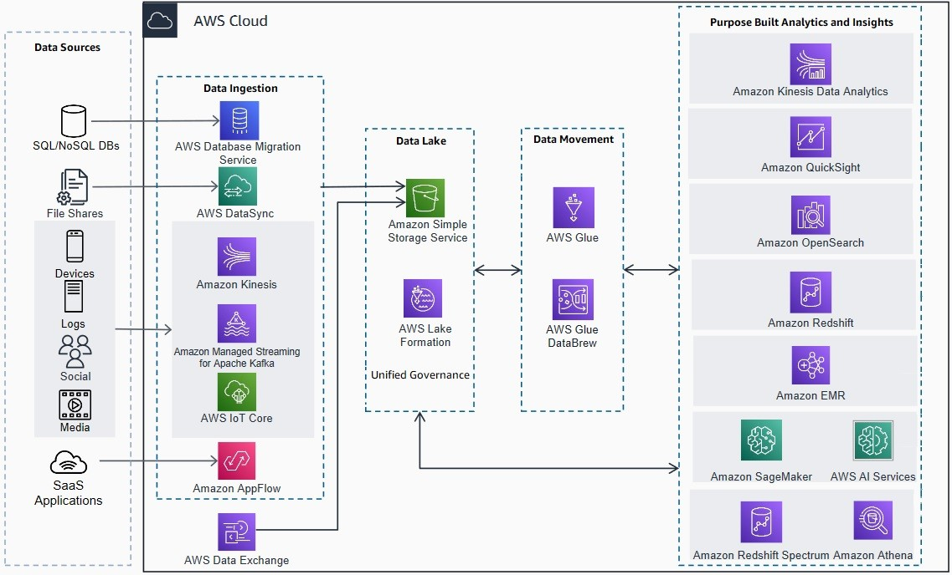
Let’s consider a mature data lake
Notes:
- Data often resides in intricate databases with multiple tables, relationships, and hierarchies, making it challenging to navigate without specialized knowledge.
- Our data can come in various formats, from structured databases to unstructured documents, and each format requires its own approach to access and interpret.
- Traditionallly, methods like SQL, require precise syntax and a deep understanding of the database schema, making it less intuitive for casual users.
- Natural language processing tools like chatbots might not always grasp the context or nuances of our specific data, leading to inaccurate or irrelevant results.
- As data grows and evolves, keeping track of changes and updates bin yoru chatbot ecomes a monumental task, affecting the accuracy and relevance of results.
Source: https://aws.amazon.com/blogs/architecture/optimize-your-modern-data-architecture-for-sustainability-part-1-data-ingestion-and-data-lake/

Slide 5




Let’s consider a hypothetical chatbot for our data lake
User
Agent
Source DB
Notes:
- Imagine a chatbot that sits atop our vast data lake, ready to fetch information at a moment's notice.
- This chatbot uses Retrieval-Augmented Generation (RAG), a method that combines the power of large language models with the precision of database retrieval.
- Instead of sifting through data manually or writing complex queries, you'd simply ask the chatbot a question in natural language.
- The RAG mechanism would first identify relevant data snippets or records from the data lake and then use those to generate a coherent, contextually accurate response.
- Such a system would democratize data access, allowing even those without technical expertise to pull insights from our data repositories.
- However, while the idea sounds promising, implementing it comes with challenges, especially when dealing with diverse, ever-evolving data landscapes.

Slide 6
Consider a Hypothetical Chatbot for our Data Lake
How many employees are there?
select* from …
Source DB
Notes:
Imagine walking into a vast library without a catalog and asking a librarian for a specific book. That's the challenge we're presenting to our AI agent.
We want to inquire about the number of employees, a seemingly simple question. But without context, the AI is somewhat in the dark.

Slide 7
Let’s consider a table of employee records…
CREATE TABLE HR_EmployeeDetails (
EmployeeID INT PRIMARY KEY AUTO_INCREMENT,
FirstName VARCHAR(50) NOT NULL,
LastName VARCHAR(50) NOT NULL,
MiddleName VARCHAR(50),
FOREIGN KEY (DepartmentID) REFERENCES Department(DepartmentID),
FOREIGN KEY (ManagerID) REFERENCES Employee(EmployeeID)
);
Notes:
Let’s assume that this is the read structure of our database table

Slide 8
Large Language Model – As Is
How many employees are there?
select count(employee_id) from employees
We call this ‘hallucination’
Notes:
Gwnerative AI models, when posed with such a query, might guess or "hallucinate" an answer based on their training data, which might not be accurate or relevant to our specific database.
The absence of any context about the database structure means the AI doesn't know where to look, what tables to query, or what relationships to consider.
This experiment highlights the importance of context and structure when querying vast data repositories. Without it, even the most advanced AI can struggle to provide accurate, meaningful answers.
Now lets explore how we can equip our AI with the tools and knowledge it needs to navigate our database effectively and provide precise answers.

Slide 9
Large Language Model + Table Context
CREATE TABLE HR_EmployeeDetails (…)
How many employees are there?
select count(EmployeeID) from HR_EmployeeDetails
It works… but only for one table…
Notes:
- Think of our earlier library analogy. Now, we're giving the librarian a catalog, a tool to guide them to the right bookshelf and section.
- By providing the AI agent with context about our database schema, we're essentially giving it a roadmap to navigate the vast data landscape.
- This context includes information about tables, relationships, and the nature of the data stored. It's like telling the AI where to look and what to consider.
- With this added knowledge, the AI can make more informed decisions, reducing the chances of "hallucinating" or making educated guesses.
- We anticipate that this context will significantly improve the accuracy of the AI's responses. It's the difference between searching in the dark and searching with a flashlight.
- The initial results are promising when we provide the AI with schema context. But this method has its limitations, especially in dynamic and vast data environments.
Databases in real-world scenarios are not static. They evolve, expand, and change. If our database is always changing, how often would we need to update the AI's context?
Imagine the complexity when dealing with large-scale databases. If we have 1,000 tables, providing the entire schema as context becomes impractical and overwhelming for the AI.
And then there's the challenge of data lakes. With potentially hundreds of databases, each with its own unique schema, the task becomes even more daunting.
Relying solely on schema context is not scalable or efficient. We need a solution that can adapt to these challenges, ensuring accurate and timely responses regardless of the size or complexity of our data landscape.
What else can we do here?

Slide 10
Fine-tuned Large Language Model
How many employees are there?
Select count(EmployeeID) from HR_EmployeeDetails
It works… but we have to retrain it every time we add a table
Notes:
Fine-tuning is a common approach to adapt language models to specific tasks. By training the model on a subset of relevant data, we aim to improve its performance on specific queries.
In our case, we tried fine-tuning the model to act as a 'database catalog', hoping it would better understand and navigate our database schema.
While the initial results might seem promising, there are inherent challenges with this approach. Using a language model as a database catalog is like asking it to remember every detail about our data structure.
As we scale up, the model's reliability starts to wane. Remembering intricate details of vast and complex databases is not what these models were primarily designed for.
Research and practical implementations have shown that this method becomes increasingly unreliable as the size and complexity of our data grow.
While fine-tuning offers a potential solution, it's clear that relying on it alone, especially in large-scale environments, is not the most efficient or reliable approach. We need to consider alternative strategies to truly harness the capabilities of conversational AI for our data lake.

Slide 11
The Real Challenges of "Talking" with Our Data
Schema Hallucination: Off-the-shelf LLMs lack knowledge of our specific schema, making data retrieval a challenge.
Limited Context: While we can provide schema context to LLMs, it's feasible only for a handful of tables at once.
Constant Fine-Tuning: Any table modification necessitates re-training, making the process cumbersome and inefficient.
Beyond Databases: The complexities multiply when considering data outside structured databases.
Notes:
Schema Hallucination: When we ask a question to an off-the-shelf LLM, it doesn't have prior knowledge of our specific database schema. This means it might "hallucinate" or guess table names or structures, leading to inaccurate or irrelevant answers.
Limited Context: One way to guide the LLM is by providing it with context, like the schema of our database. However, this is only practical for a few tables. If we have hundreds or thousands of tables, it's impossible to provide all that context in a single prompt.
Constant Fine-Tuning: If we decide to fine-tune the LLM on our database schema, we face another challenge. Every time there's a change to a table, or a new table is added, we'd need to re-train the model. This is not only time-consuming but also resource-intensive.
Beyond Databases: Our data landscape is vast. While structured databases are a significant part of it, we also have unstructured data, semi-structured data, and data in various formats and systems. Addressing the challenge of conversing with this diverse data landscape requires a more holistic approach than what traditional methods offer.
In essence, while LLMs are powerful, making them effectively "converse" with our data requires more than just out-of-the-box solutions or simple tweaks. We need a strategy that understands and addresses these core challenges.

Slide 12
We need a new type of agent
Notes:
Traditional methods and off-the-shelf LLMs, while powerful, have shown limitations when it comes to understanding and interacting with our specific data landscapes.
The ideal agent should inherently understand our database schema without us having to constantly provide context or fine-tune it with every minor change.
This agent would not just be limited to structured databases but should be adept at navigating through diverse data types, be it structured, semi-structured, or unstructured.
It should be scalable, capable of handling vast amounts of data across multiple tables, databases, and even across different systems without getting overwhelmed.
The goal is to have an agent that can seamlessly integrate into our data ecosystem, making data retrieval as simple as having a conversation.
In short, to truly harness the power of our data and make it accessible, we need an agent that is tailored to our unique challenges, one that brings our data lake into the conversation.

Slide 13
It first learns what each dataset can tell us
Knowledgebase
Source DB
For every table, tell me the questions it can answer
Notes:
At the heart of the A-RAG system is its unique ability to understand and interpret each dataset in our data lake.
Visualize a flow where the source database feeds into the A-RAG agent. This agent, equipped with its advanced capabilities, dives deep into each table of the database.
The prompt "For every table, tell me the questions it can answer" drives the agent's exploration. It's not just about understanding the data but discerning the kind of questions the data can address.
As the agent processes each table, it generates a series of hypothetical questions that the table can answer. This becomes a knowledge base, a repository of potential questions linked to specific tables.
This knowledge base serves as a bridge between user queries and the relevant datasets. When a user poses a question, the agent consults this knowledge base to determine the best dataset to retrieve the answer from.
By first understanding what each dataset can tell us, the A-RAG agent ensures that every user query is directed to the most relevant source of information, optimizing accuracy and efficiency.

Slide 14
Asymmetric Retrieval Augmented Generation (A-RAG)
patient_id|patient_name|patient_age|patient_address|patient_phone|last_contact|email
Input Schema
Hypothetical questions
How many patients are over the age of 18?
Who is the oldest patient?
What is the address of patient ‘John Doe’?
Notes:
Let's delve deeper into the mechanics of how A-RAG interacts with a specific dataset, in this case, a patient information table.
Visualize the schema of our patient information table. It might contain fields like PatientID, Name, Age, Diagnosis, Treatment, and LastVisitDate.
The A-RAG agent, upon analyzing this schema, starts to generate a series of hypothetical questions. These aren't random questions but are intricately tied to the structure and nature of the data in the table.
For instance, from the Diagnosis and Age fields, A-RAG might generate questions like "How many patients above 60 have been diagnosed with hypertension?" or "What's the average age of patients diagnosed with diabetes?"
From the Treatment and LastVisitDate fields, questions could arise such as "Which patients received physiotherapy in the last month?" or "How many patients were prescribed medication X in the past year?"
These hypothetical questions serve multiple purposes. They not only provide a glimpse into the kind of information the table holds but also set the stage for real user queries. When a user asks a question, the A-RAG agent can match it with these hypothetical questions to pinpoint the right table and retrieve accurate answers. So, as you can see, this agent can understand and interpret schemas, which is key for conversational data access

Slide 15
Find the right table, with the right question
"If your question sounds like one the agent guessed, they probably come from the same data”
Notes:
At the heart of our A-RAG system lies a simple hypothesis: If a user's query closely resembles a hypothetical question the agent has generated, they are likely pointing to the same dataset.
This principle is grounded in the idea that data inherently has a 'voice' or 'language' of its own. By generating hypothetical questions, we're essentially capturing this voice.
When users pose questions, they're tapping into this same voice, even if they're not directly aware of the dataset's structure or specifics.
The closer the match between the user's query and one of our hypothetical questions, the higher the confidence that we've identified the right dataset to pull answers from.
This approach sidesteps many of the challenges traditional systems face. Instead of relying on explicit schema prompts or constant fine-tuning, we're leveraging the natural language understanding capabilities of the A-RAG to intuitively match questions to datasets.
In essence, we're allowing the data to speak for itself, and our agent acts as an interpreter, bridging the gap between user queries and the vast information stored in our data lake.

Slide 16

From hypothetical, to real user questions…
Knowledgebase
select * from y
How many employees are there?
Closest matching question is X from table Y
Source DB
Notes:
The core strength of the A-RAG system lies in its ability to match real-world queries with its bank of hypothetical questions. This matching process is the key to pinpointing the right dataset.
When a user poses a question, the system doesn't start from scratch. Instead, it looks for similarities between the user's question and the hypothetical questions it has already generated.
This is not a mere keyword match. The system delves deeper, understanding the semantics and context of the user's query, ensuring a more nuanced and accurate match.
Once a close match is found, the system doesn't just stop at providing an answer. It identifies the source table from which the hypothetical question was derived, indicating where the most relevant data resides.
This approach bypasses the need for explicit schema knowledge or manual table selection. The system intuitively navigates the data landscape, streamlining the process of data retrieval.
In essence, the A-RAG system transforms the vast and complex data lake into an accessible and user-friendly conversational interface, making data-driven insights more attainable than ever before.

Slide 17


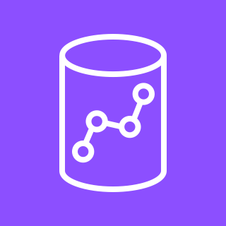

This technique can work for any data store
Amazon Simple Storage Service (Amazon S3)
Amazon Kendra
Amazon Redshift
Amazon Relational Database Service (Amazon RDS)
Knowledgebase
For every table/record/document/file, tell me the questions it can answer
Notes:
The versatility of the A-RAG system is one of its standout features. It's not confined to structured databases; it can seamlessly interact with a myriad of data stores, be it tables, records, documents, or even files.
This adaptability ensures that organizations are not limited by the type or structure of their data. Whether you're dealing with structured SQL tables or unstructured documents, A-RAG can handle it.
Our tests with Amazon Kendra further underscore this capability. Kendra, unlike traditional databases, doesn't rely on a fixed schema. Yet, the A-RAG system was able to effectively interact with it.
By simply retrieving a random sample of records from Kendra, the system could generate hypothetical questions, showcasing its ability to adapt to different data landscapes.
This means businesses can now have a unified conversational interface for their entire data ecosystem, irrespective of the diversity or complexity of their data sources.
In essence, A-RAG bridges the gap between varied data sources and user queries, ensuring that valuable insights are always within reach, regardless of where the data resides.

Slide 18
How Can I Build This?
Notes:
Traditional methods and off-the-shelf LLMs, while powerful, have shown limitations when it comes to understanding and interacting with our specific data landscapes.
The ideal agent should inherently understand our database schema without us having to constantly provide context or fine-tune it with every minor change.
This agent would not just be limited to structured databases but should be adept at navigating through diverse data types, be it structured, semi-structured, or unstructured.
It should be scalable, capable of handling vast amounts of data across multiple tables, databases, and even across different systems without getting overwhelmed.
The goal is to have an agent that can seamlessly integrate into our data ecosystem, making data retrieval as simple as having a conversation.
In short, to truly harness the power of our data and make it accessible, we need an agent that is tailored to our unique challenges, one that brings our data lake into the conversation.

Slide 19
Choose a Large Language Model (LLM)

Slide 20
Choose Amazon Kendra

Slide 21
Or, Choose a Vector/Search Database

Slide 22
Now lets put it all together
AWS Architecture here
Notes:
AWS offers a robust ecosystem for data storage and management. Our architecture leverages these services to ensure efficient data retrieval and processing, making the most of AWS's scalability and reliability.
At the heart of this setup is the A-RAG agent, which interfaces with diverse data sources within the data lake. Whether it's structured data in Amazon RDS, unstructured data in S3 buckets, or even streaming data from Kinesis, the agent is equipped to handle it.

Slide 23
Demo
Notes:
Online advertising is a dynamic and data-rich industry. Every click, impression, and conversion generates data, making it an ideal environment to showcase the agent's prowess.
In this demo, we'll be querying data that spans various aspects of online advertising: from ad performance metrics to user demographics and click-through rates.
The objective here is not just to retrieve data, but to do so in a conversational manner. We aim to demonstrate how seamlessly the agent can understand and respond to user queries, even in such a complex domain.
As we navigate through the demo, pay attention to how the agent leverages the hypothetical questions it has generated. This is the crux of the A-RAG methodology, and it's what enables the agent to pinpoint the right data sources.
By the end of this demonstration, you'll have a clear understanding of how transformative the A-RAG agent can be, turning vast data lakes into accessible, conversational reservoirs of insights.

Slide 24

Scan for slides
Notes:
Online advertising is a dynamic and data-rich industry. Every click, impression, and conversion generates data, making it an ideal environment to showcase the agent's prowess.
In this demo, we'll be querying data that spans various aspects of online advertising: from ad performance metrics to user demographics and click-through rates.
The objective here is not just to retrieve data, but to do so in a conversational manner. We aim to demonstrate how seamlessly the agent can understand and respond to user queries, even in such a complex domain.
As we navigate through the demo, pay attention to how the agent leverages the hypothetical questions it has generated. This is the crux of the A-RAG methodology, and it's what enables the agent to pinpoint the right data sources.
By the end of this demonstration, you'll have a clear understanding of how transformative the A-RAG agent can be, turning vast data lakes into accessible, conversational reservoirs of insights.

Slide 25
Mamoon Chowdry
Chowdry@amazon.com

